Slide 1

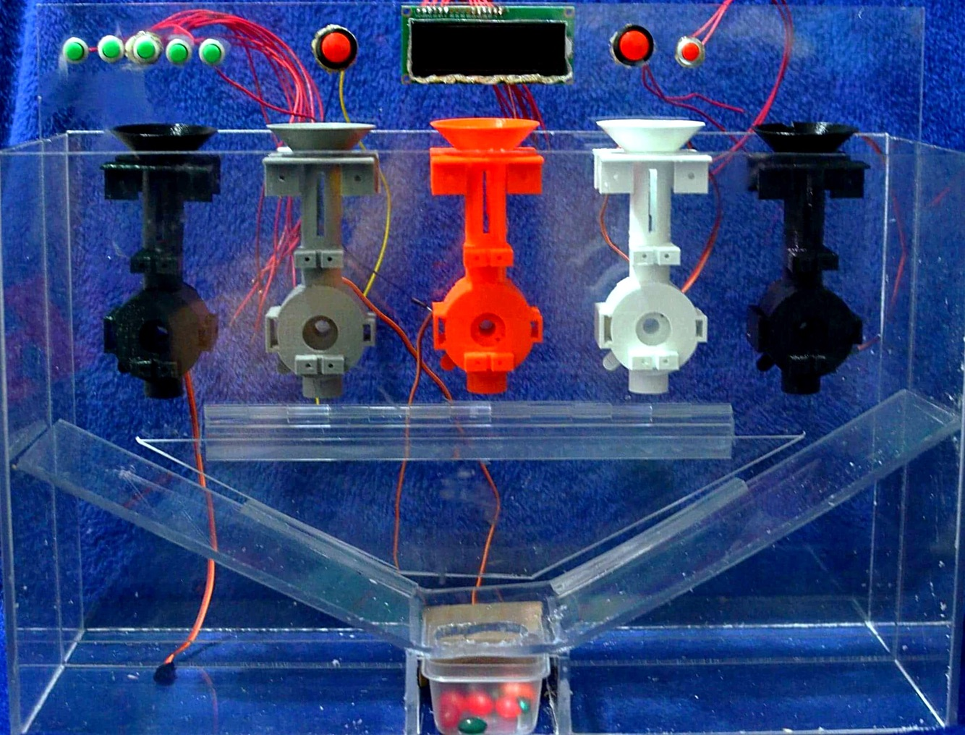
Automated Pill Dispenser
Russell Epstein, Thomas Ippolito, Kameron Bynum, Jonathan Zelaya, Christopher Lopez
Prof. Nagi Naganathan (Group 06)
Project Overview
How It Works
In this project, we are building a machine to sort and dispense a user’s pills for them using an Arduino microcontroller. The user will pour each pill box separately into the machine’s individual funnel compartments, then use the buttons and LCD screen to designate how many pills per day the user will need of each type, and set the time of day that they’d like to take their pills.
Simple step by step instructions detailing how to operate the Pill Dispenser. Can be expanded upon further and included with the machine to assist those operating it.
Dump prescription bottle 1 into funnel #1
Use button left of the LCD screen to save setting
Repeat process for up to four other different types of pills
Use button for funnel on the top left to set how many pills you need at a time
Use the hour and minute buttons on the right of the LCD screen to set time pills are needed.
Once the set time occurs, an alarm goes off and pills are dispensed from each funnel
Motivations/Objectives
Motivations/Objectives
Elderly/disabled people often need a lot of care and attention, this could provide caretakers an easier and more efficient method of making sure their patients know when to take their medication.
Problems especially arise when someone has a large number of medications to remember, while this would simplify things, saving time and energy.
Final Design
The completed design includes five funnels along with their respective control buttons, buttons to set the hour and minutes, and an “Okay” button..
The pills drop out of the funnels and roll down the slanted walls into the dispense tray.
Design Challenges
An issue we faced was 3D printing all the parts, Makerspace had issues with our parts and so we had to go elsewhere.
An issue with the software was designing around Arduino’s iterative and sequential architecture (infinite loop).
Another issue was deciding on the best design in terms of simplicity and efficiency. We went through several different design drafts before we found a good balance.
Conclusion and Future Work
dsafadfdsafsafsdfdafdjkjkl;jkljkljkl;jkl;
This served as a prototype and proof of concept that could be beneficial for thousands of people
In the future, a website or app can be used to control/monitor remotely, especially in large settings such as hospitals or nursing homes
We were able to achieve a simple UI, thus making it easy for users to setup and use the machine

